Slide 1

Winning breakfast, generation by generation
Presented by:
Feb 1, 2022

Slide 2
Agenda
Breakfast in the macro environment
Covid affect on health choices
Breakfast trends across generations
Factors of eating out
Opportunities for engagement
How KIND can stay winning

Slide 3


Breakfast is winning, despite inflation and supply chain issues
The economic climate has created many swings across many factors
Total store sales are up 5% vs. YA
Total store unit sales are down -1.6%
Retail sales up +16.9%
Inflation up +7%
Breakfast trends are on the rise
Online, convenience, variety, and versality are positively impacting sales
95% of consumers eat morning foods in a typical week
Total breakfast is up 4% vs. 2020
Breakfast snacks and granola are up +11% in dollar sales vs. a YA
Source: IRI, Winning Breakfast Generation by Generation Webinar, February 1, 2022
Notes:
Weekends are important

Slide 4
The Covid pandemic has made consumers more health conscious
42% of the population gained an average of 29 pounds during the pandemic
Consumers are prioritizing health across generations, pushing the trend of healthier options for breakfast
67%
Of respondents said they prioritize healthiness for their morning food and beverage choices
51%
Of respondents said they look for specific nutritional benefits in their morning food
30%
Of respondents said that immunity benefits are one of the main things they think about when deciding what to eat in the morning
Consumers are choosing healthier options about 19% on average, across generations
Source: IRI, Winning Breakfast Generation by Generation Webinar, February 1, 2022
Notes:
Call out benefits like nutrition

Slide 5





Breakfast is an important meal across generations, but the meal differs by age group
Gen Z + Millennials | Older Millennials | Gen X | Younger Boomers | Older Boomers
Milk Fruit Juice | Milk Carbonated Beverage | Fruit Juice Tea | Protein Shakes Eggs | Coffee Fruit Juice
Tea Yogurt | Protein Shakes Eggs | Carbonated Beverage Protein Shakes | Yogurt Protein Bars | Eggs Beef/Pork protein
Protein powders Frozen fruit | Poultry/Fish Yogurt Bars | Yogurt Protein Bars | Hot Cereal | Cold cereal Hot cereal
Packaged fruit Fresh bakery | Protein Bar Frozen Fruit | Cold Cereal, Packaged fruit, Bread |  | Fresh fruit Bread
Granola Cereal bars | Granola/Cereal Bars Packaged Donuts | Fresh Bakery Items Granola/Cereal Bars
Source: IRI, Winning Breakfast Generation by Generation Webinar, February 1, 2022

Slide 6

Breakfast trends cont.
Mini Breakfast
Full Breakfast
Morning Snack
Morning Fuel-Up
Workout Fueling
Across generations, consumers described their morning meal
23%
Full Breakfast
17% Morning Fuel-Up
31%
Mini/Small Breakfast
21%
Morning Snack
Source: IRI, Winning Breakfast Generation by Generation Webinar, February 1, 2022
Notes:
Consumers eat across the morning, increase frequency in C cannel

Slide 7

Consumers are eager to get out of the house, citing ease and indulgence as key factors
Indulgence, convenience, and change of scenery are the top reasons for breakfast out of the home for consumers
35%
It feels like a little indulgence
28%
Quicker than making something at home
29%
It’s nice to get out of the house
20%
There is no clean up
Convenience channels are seeing high growth across consumers
Generations that frequent C-store:
Gen Z + Millennials
Older Millennials
Gen X
Source: IRI, Winning Breakfast Generation by Generation Webinar, February 1, 2022

Slide 8
There is opportunity to strengthen consumer engagement during breakfast
4 in 10 people often skip breakfast. Differences can be seen across generations
95% of consumers eat breakfast foods in a typical week
Gen Z/ Younger Millennial
Older Millennial
Gen X
Younger Boomers
Older Boomers
56%
20% of grocery spending allocated to morning foods
43%
41%
12% increase in eating in the morning since start of pandemic
38%
30%
Breakfast foods hold weight in consumers’ lives overall
Source: IRI, Winning Breakfast Generation by Generation Webinar, February 1, 2022

Slide 9


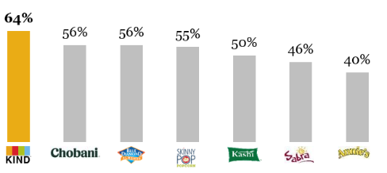
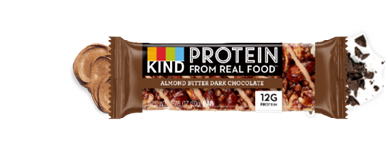
KIND’s top guardrails aligns with the healthy and convenient breakfast trends
“Consumers are prioritizing health across generations”
“Convenience channels are seeing high growth across consumers”
Guardrail #1
Healthy and Tasty
Guardrail #2
Convenient
“Nutrient dense first ingredient, minimal sugar, delicious”
“Making eating healthier easier”
KIND ranks #1 on consumers’ perspective of health
KIND can capitalize on protein trend and convenience with protein bar singles
Images and charts from “KIND Overview and One Pagers Oct. 2020”

Slide 10
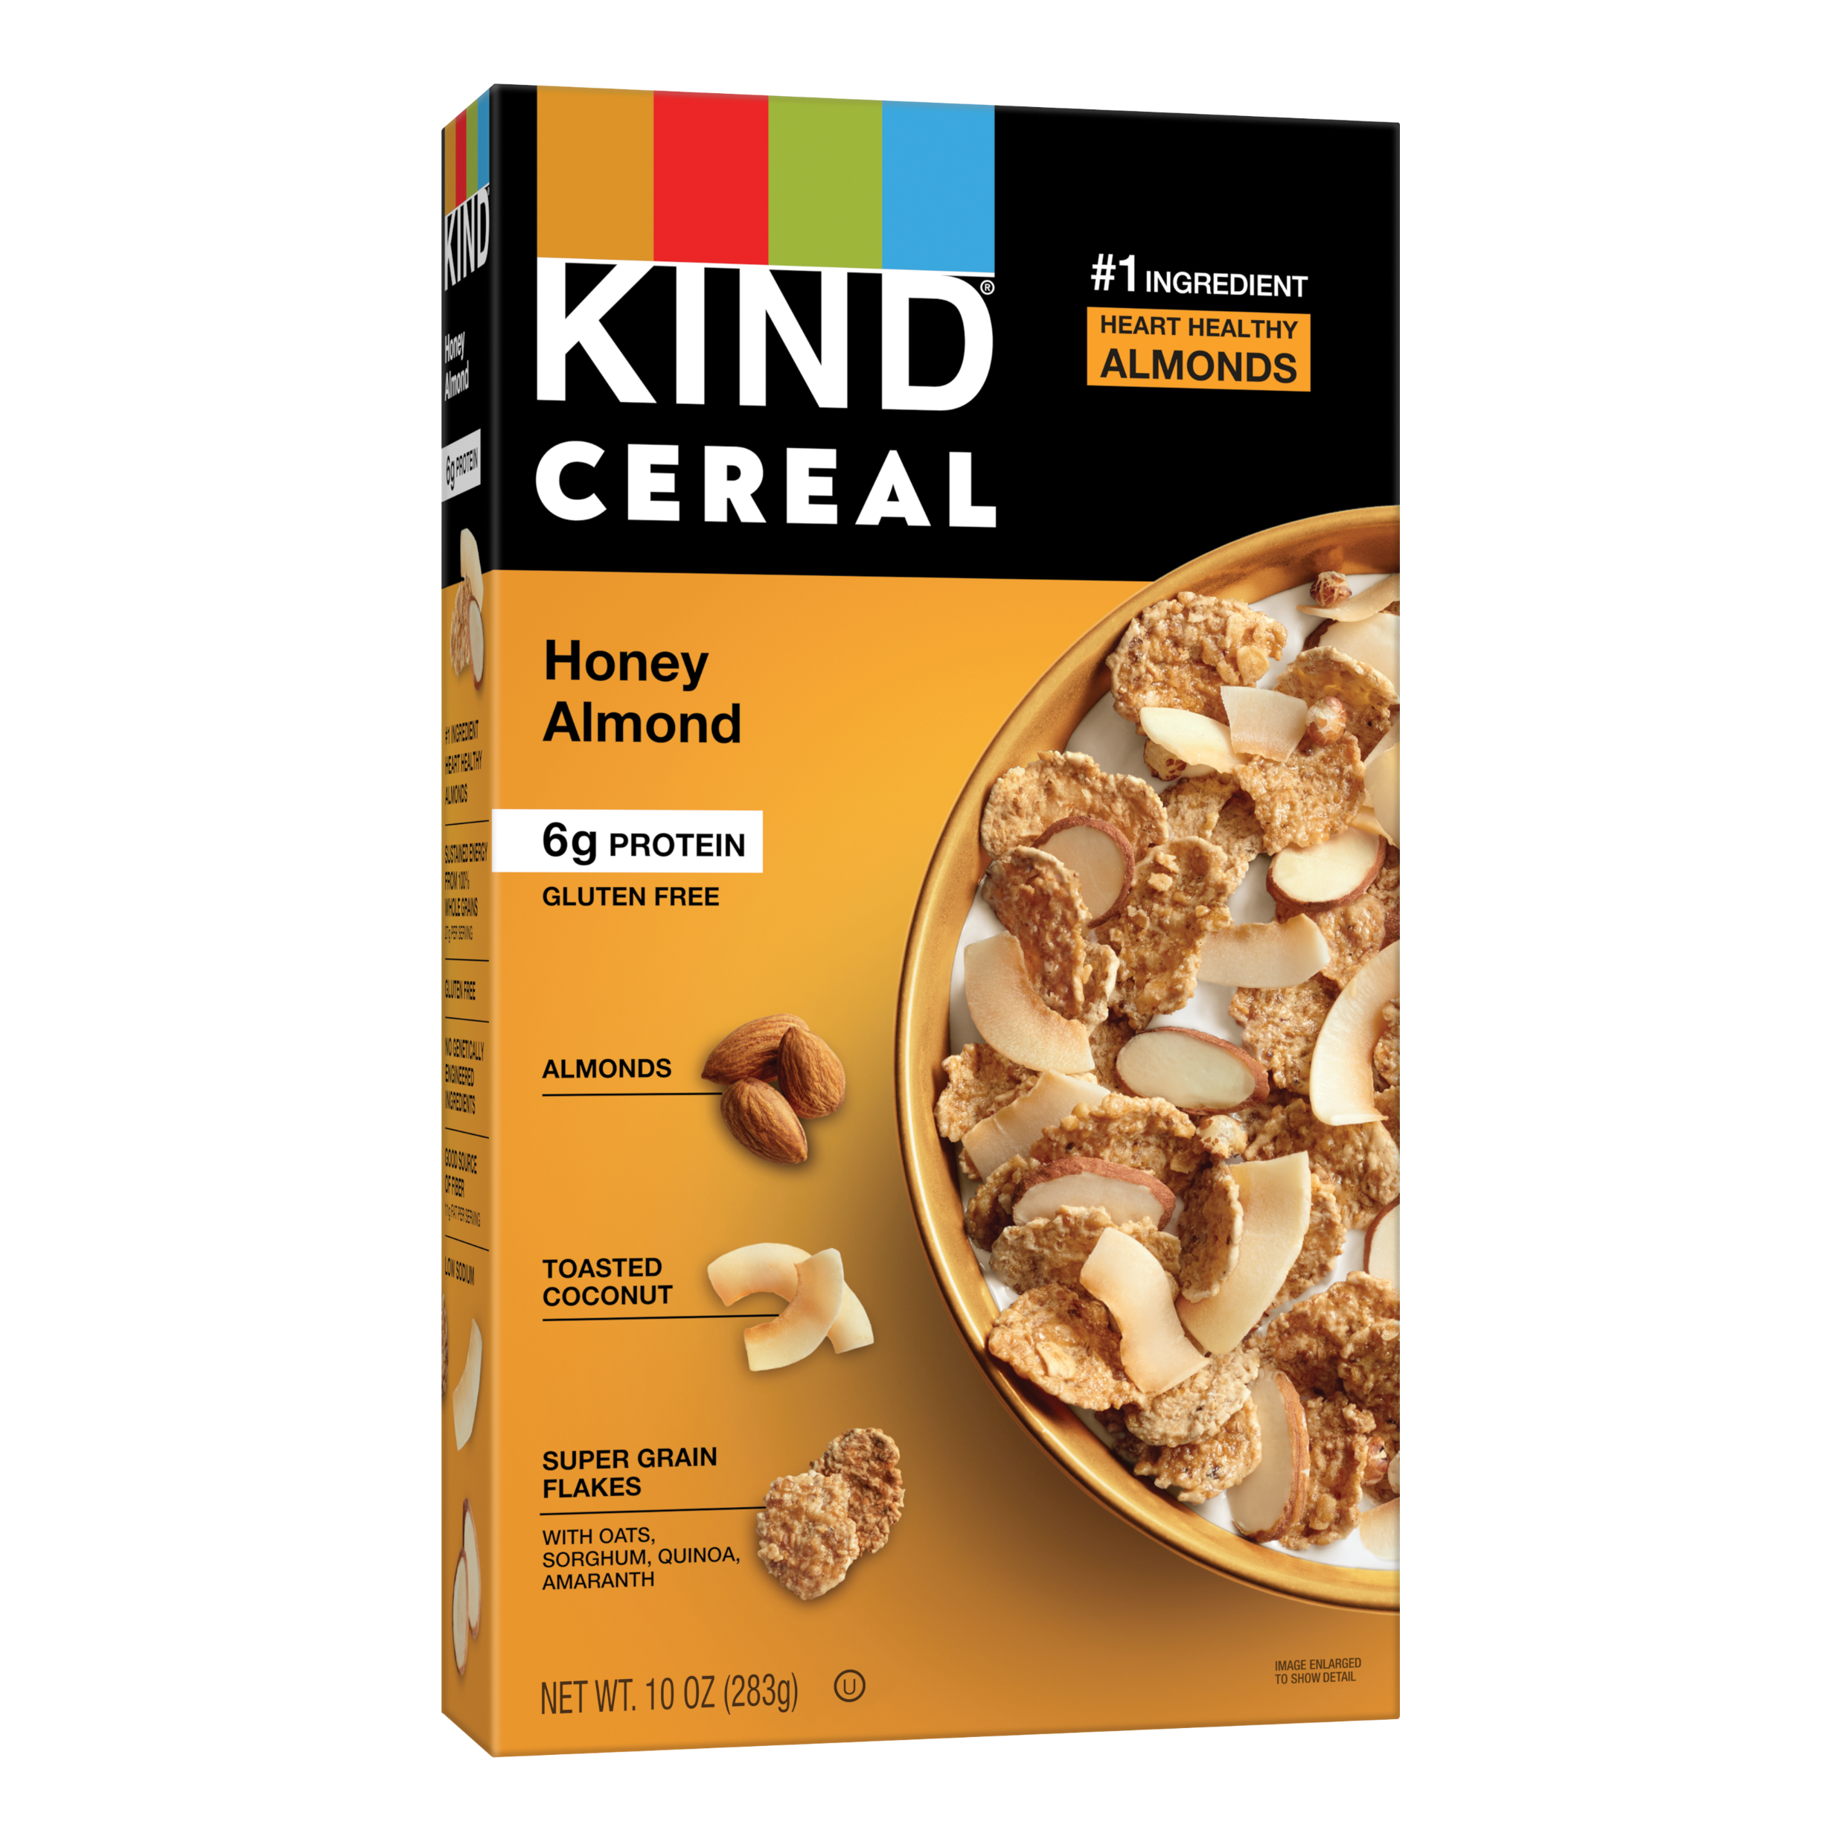
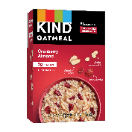


KIND’s Promise aligns with the top 3 attributes consumers are looking for in breakfast
Important Attributes When Selecting Breakfast
54%
54%
51%
Healthy
Quick to Prepare
Flavorful
Something we did for a past webinar
KIND’s Promise is Giving Consumers What They Want…
Guardrail #1
Convenient
Guardrail #2
Healthy & Tasty
Guardrail #3
Real
Makes eating healthy easier
Created for convenience
Nutrient rich ingredients
Minimal sugar
Uncompromisingly Delicious
Ingredients you can see and pronounce®
No artificial sweeteners, preservatives, colors or flavors
Source: Mintel Breakfast Foods: Incl Impact of COVID-19 October 2020
Q: Which of the following claims are important to you when selecting a breakfast item? Please select all that apply.
4
KIND Management Inc. – Confidential

